Slide 1
Packard Power Rankings
By: Bryan Bonilla, Chris Brandt, Kyle Verbrugge

Slide 2
Overview
Packard Power Rankings is a website that power ranks various sports throughout Colorado and the US such as Colorado High School Men’s, and Women’s Basketball, and College Football
This website utilizes an algorithm created by Eric Packard to Power Rank these teams, and is highly regarded in the sports community
This being said, our project this last semester has been to try and fix any bugs with the site, and improve overall performance on this site for the user

Slide 3


Software Management
GitHub
Used as our version control
Used as place to keep track of all project issues
Each Sport Has Its Own Branch
AWS
Hosts Web-Server
Workflow
Create branch named after issue
Merge with sport's main branch
Remote Repo -> AWS Repo -> AWS srv directory

Slide 4
Teamwork
Microsoft Teams
Center of Communication
Documentation
Weekly In-Person Standups
Briefed Progress
Client Communication

Slide 5
Documentation
This project has several different forms of documentation.
README.md – README on the Github gives some basic info about the project to help team members initialize their environment for testing
Developer Documentation – There’s several developer docs that describe the functionality of the python files that make up the project, and the AWS backup system
Video Guides – Along with documentation for the developer this project also has several video guides for the client to demonstrate how to add new data to the system.

Slide 6
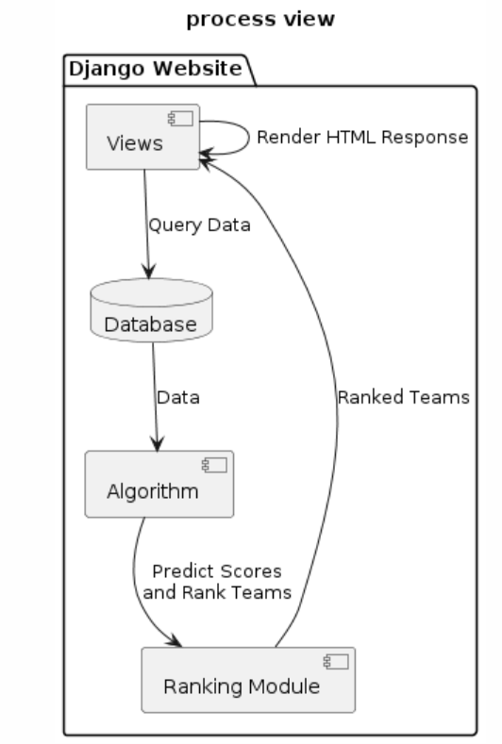
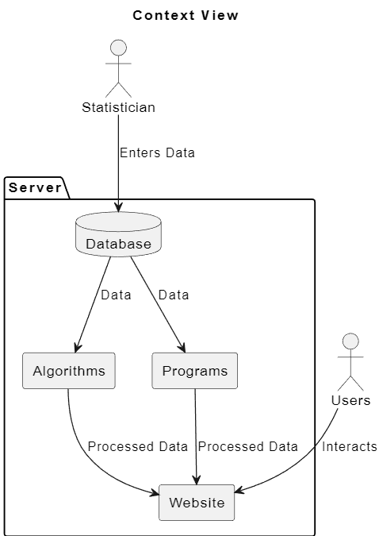
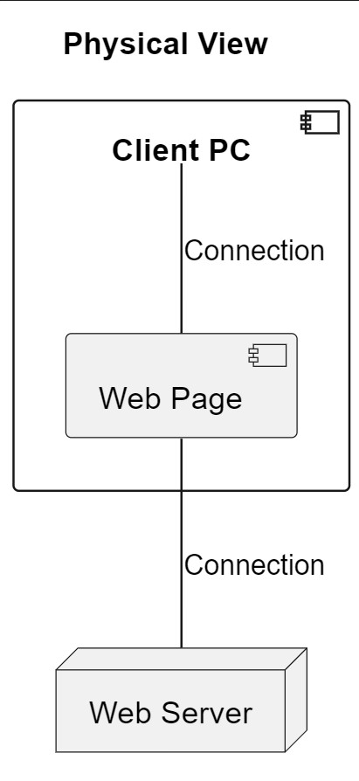
4+1 Views

Slide 7
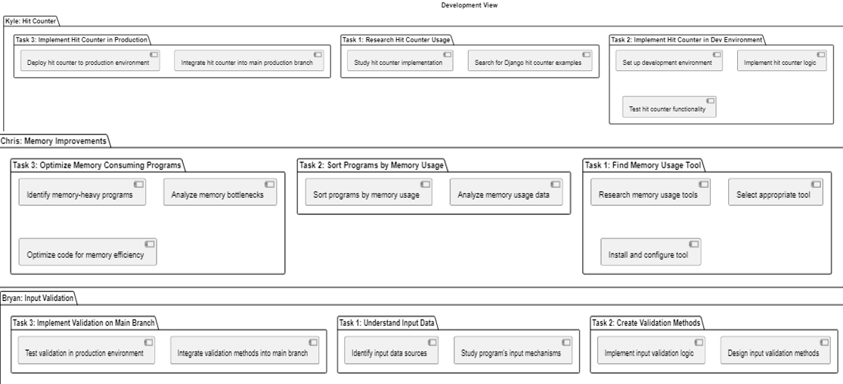
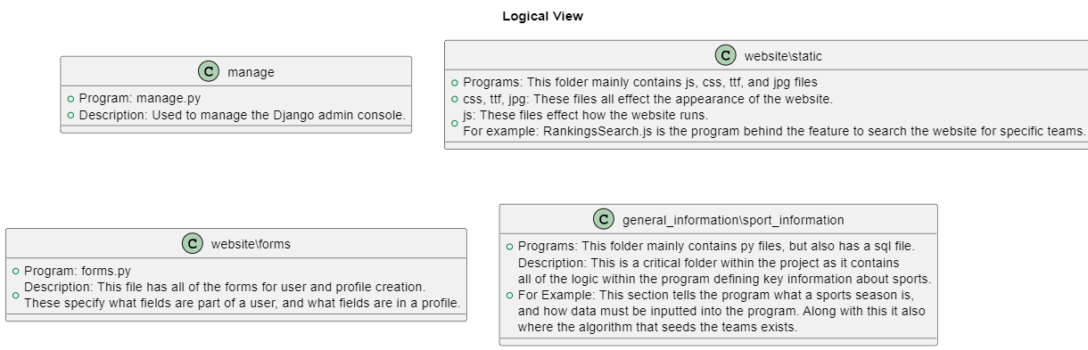

Slide 8
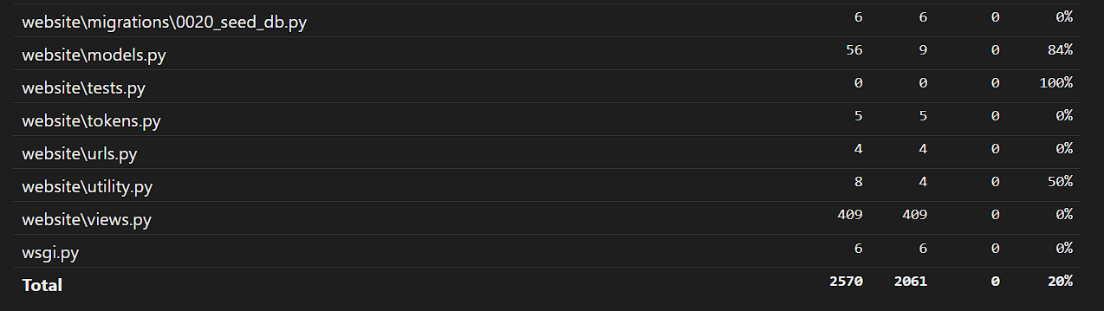
Testing
Numerous Developed Python Files
Coverage Percentage: 20%

Slide 9
Individual Work

Slide 10

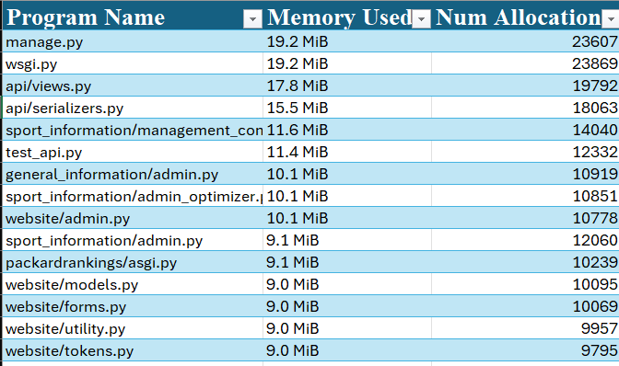
Memory Improvements
This started with first getting a good idea of the memory usage within the program using a memory profiling tool. For this I chose Memray.
Once I completed memory profiling all of the Python files within the project, I then transferred the data to an Excel Sheet, and sorted it by descending memory usage.
This allowed me to get a much better understanding of which files I should attempt to optimize first.

Slide 11
Memory Improvements Cont.
After I gathered all of the information I then started really focusing on optimization
This was a slow process at first however, I was able to significantly reduce the memory usage in multiple files throughout the project
For example: One of the most memory consuming files in the project was data-fixing.py, after optimization this program almost used 10x less memory!
However, for the website to run smoother there still needs to be a lot more optimization done within the database.

Slide 12
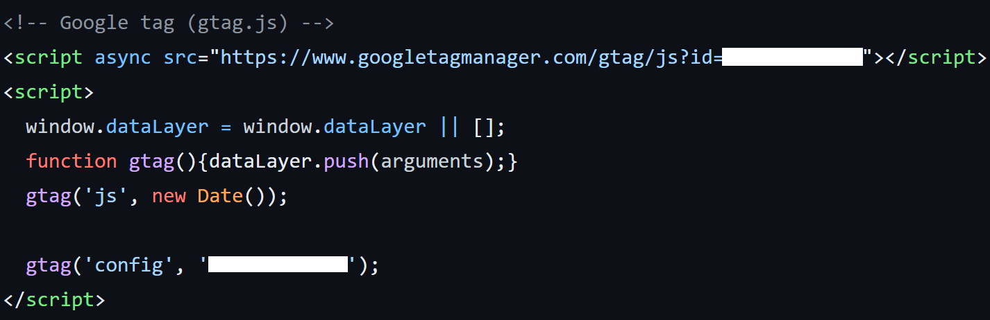
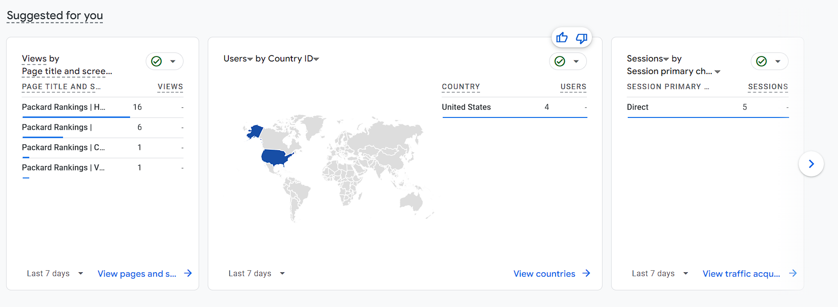
Hit Counter + Analytics
Google Analytics
Quick + Easy Setup
Free
Capabilities
Demographic
Engagement
Growth

Slide 13
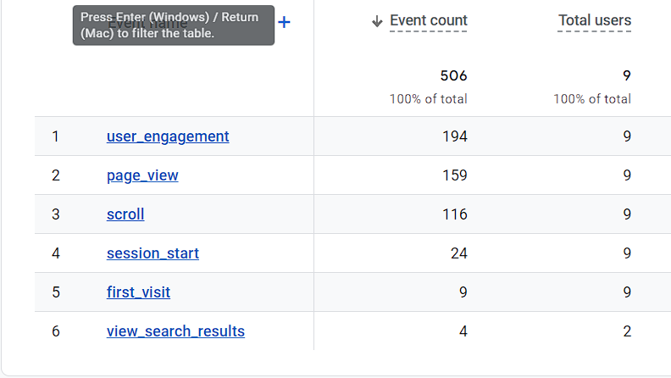

Slide 14
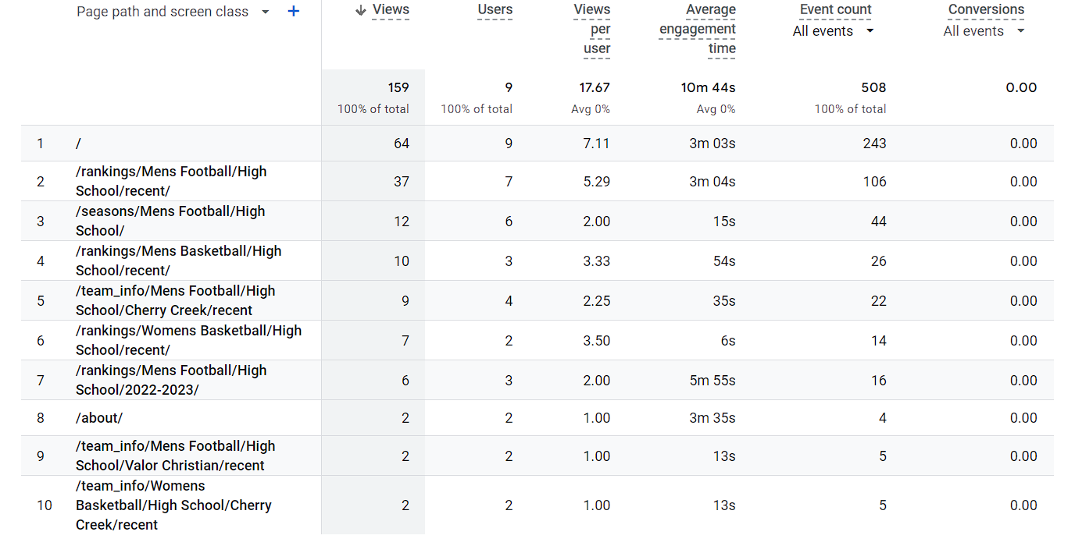

Slide 15
Input validation issue
Issues:
Ties: ties when accidently entered cause issues in the ranking algorithm
Valid date: the csv reader didn't check if an appropriate date was entered, causing unnecessary data to generated
Already existing games: games entered twice caused issues
Testing:
Django test module

Slide 16
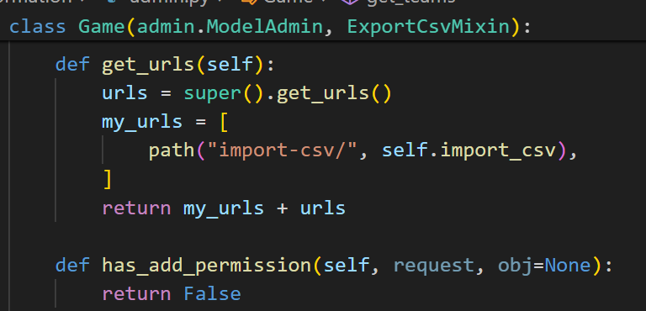

Django modules
Inheritance
Methods
Modules

Slide 17
Dealing with Setbacks: Overwritten Database
HS-Football Database was overwritten
"Take 40 Hours"
Recovered some data from October snapshot
Rest was manually entered into the database.
Where did these problems arise from
Flawed Deployment Strategies
Lack of Documentation
Better Backups

Slide 18
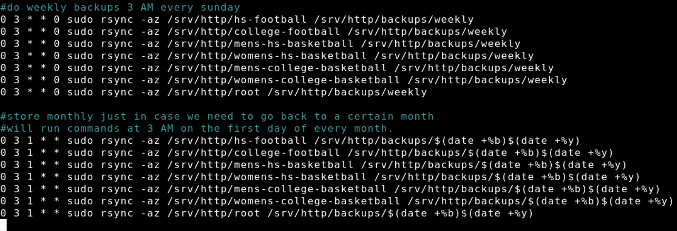
Backups using Crontabs
Short-term Weekly Backups
Gets overwritten each week
When problems quickly come to light
Long-term Monthly Backups
For problems that go unnoticed for some time

Slide 19
Learning Points
Using Git and Github properly is critical, failing to do so will not only result in confusion among your team members, but also among future developers.
Communication between your team is also incredibly important, failing to do so will result in confusion, and sometimes work will get done twice.
Time management is key!

Slide 20
Plan For Moving Forward
Utilize the second Lightsail server as a development server
Restructure the Github so that the code shown in the development branch is the code in the main branch
Potentially Revamp the Front End
Improve the database

